Slide 1



AtliQ
Hardware
Consumer Goods Ad-Hoc Insights
By: Ashish Kumar

Slide 2
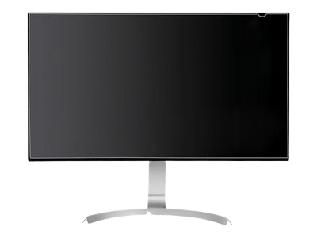
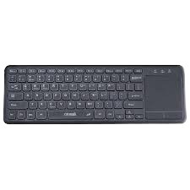
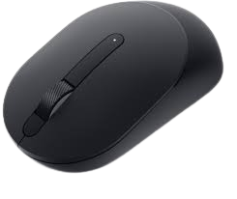
About Atliq Hardware
AtliQ Hardware, a prominent player in the hardware industry renowned for its range of products including PCs, printers, mice, and computers, is experiencing rapid growth in recent years. To maintain a competitive edge in the market and facilitate data-driven decision-making, the company has embarked on a new initiative to implement SQL-based data analytics for the first time. This strategic move aims to address various business aspects such as finance, sales, marketing, and supply chain management
Objective
The primary objective is to leverage MySQL as the database management system to overcome performance issues associated with large Excel files. AtliQ Hardware endeavors to extract actionable insights from its data repository. These insights will play a pivotal role in optimizing operational efficiency, empowering the company to make informed decisions and sustain its growth trajectory in the dynamic hardware market.

Slide 3
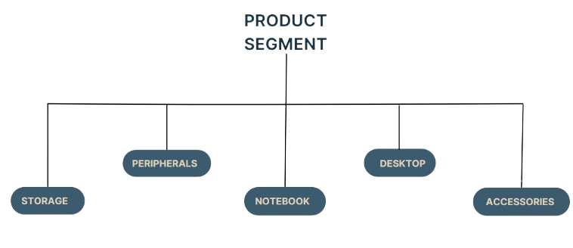
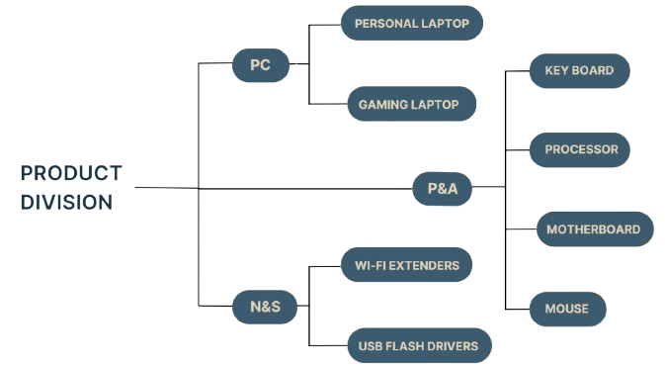
Problems Statement
The challenge at hand is to assess the financial standing of the company across different fiscal years.
Additionally, there's a need to generate a comprehensive monthly gross sales report. Furthermore, it is crucial to identify the top-performing markets, products, and customers. Additionally, addressing and providing insights for 8 ad hoc requests presented by the management team is imperative.
Ultimately, the goal is to equip the management team with data-driven insights to facilitate informed decision-making processes.

Slide 4
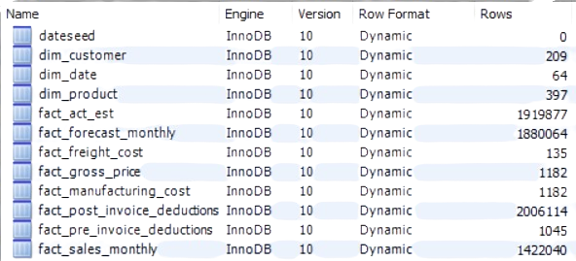
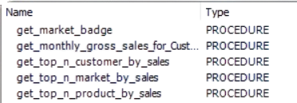
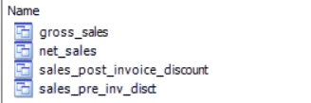
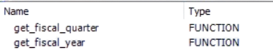
Database Overview
Tables
Stored Procedure
View
Functions

Slide 5
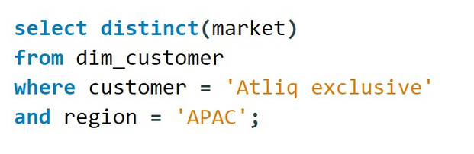
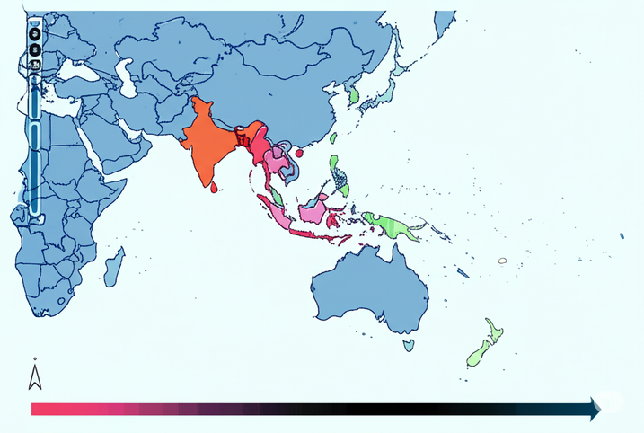
Ad-hoc insights
Provide the list of markets in which customer "Atliq Exclusive" operates its business in the APAC region
# Code
# Output
Atliq Exclusive operates it's business in 8 Markets, namely Australia, Bangladesh, India, Indonesia, ,Japan, New Zealand, Philiphines, South Korea in APAC

Slide 6
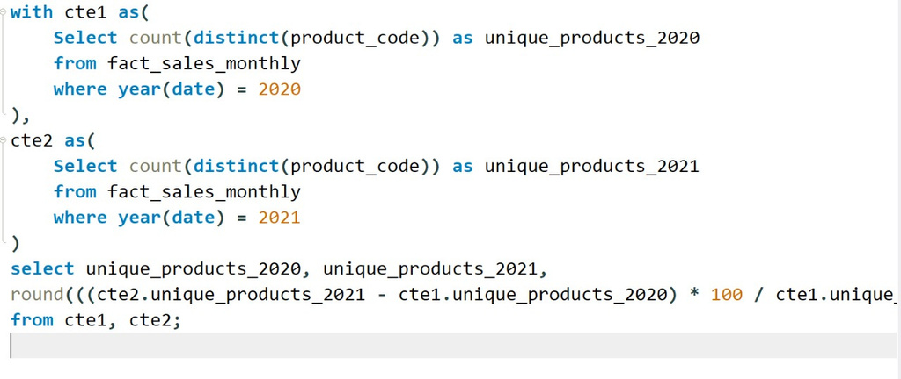
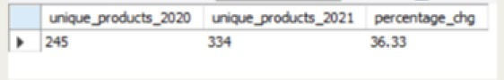
What is the percentage of unique product increase in 2021 vs. 2020?
# Code
# Output
In 2021 , the unique product count rose from 245 to 334, marking a 36.33% increase compared to previous year.

Slide 7
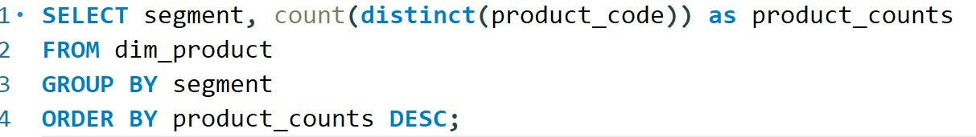
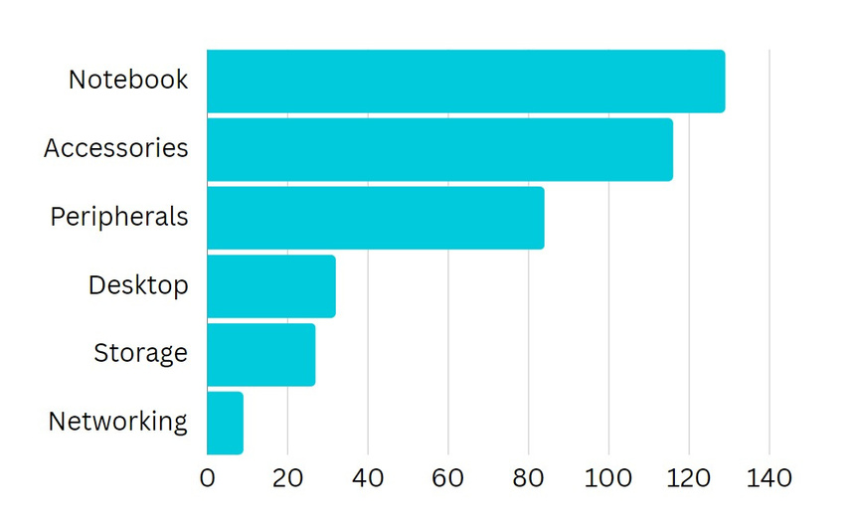
Provide a report with all the unique product counts for each segment and sort them in descending order of product counts.
# Code
# Output
Out of 6 segments, Notebook had the highest numbers of unique products,(129) and Networking has lowest number of products(9).

Slide 8
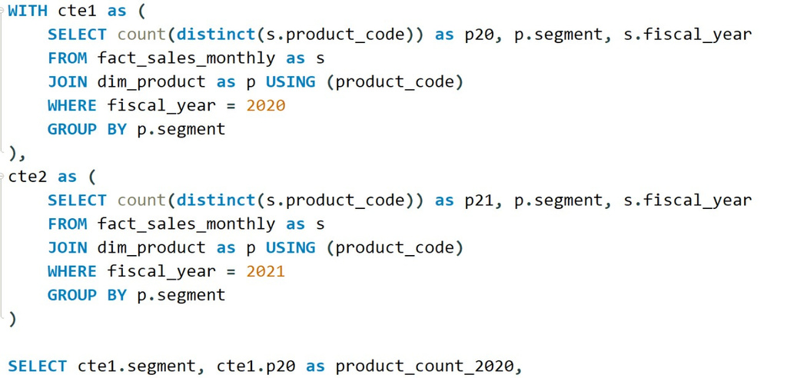
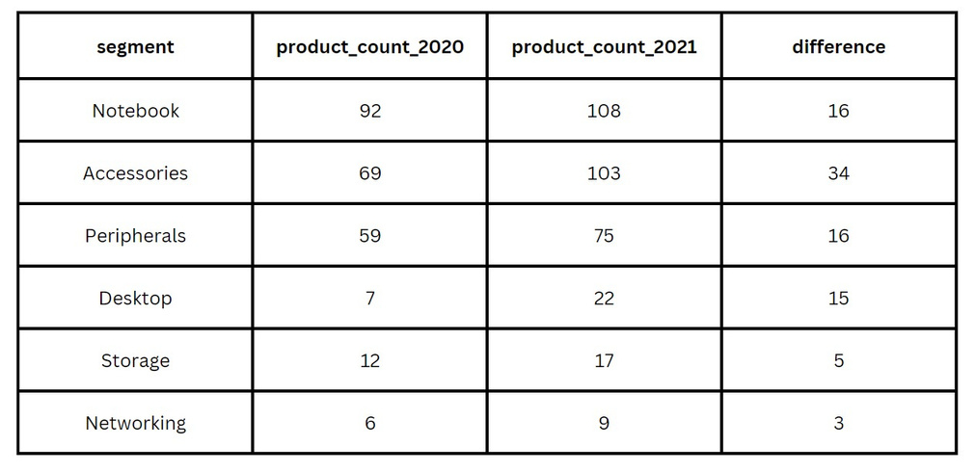
Which segment had the most increase in unique products in 2021 vs 2020?
# Code
# Output
In 2021, Notebooks added 16 new unique products, reaching 108. However, Accessories added 34 products, reaching a total of 103, making it first in terms of growth

Slide 9
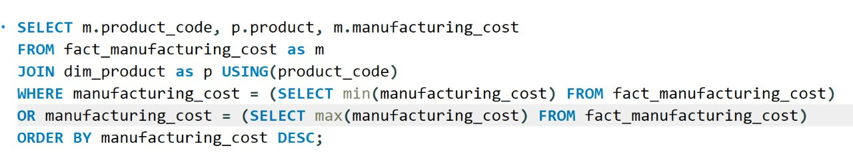
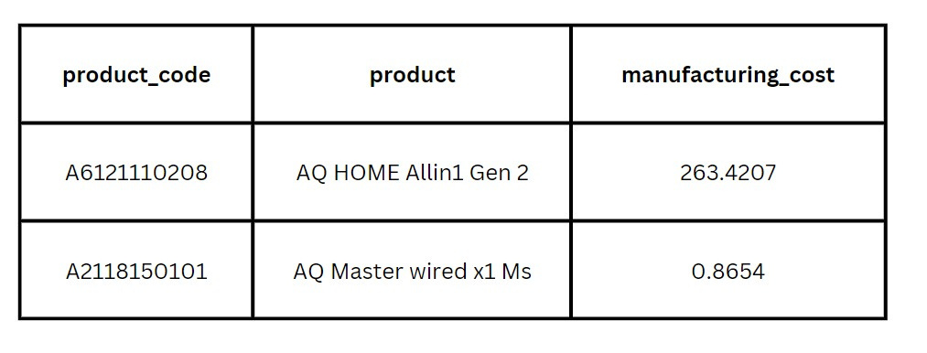
Get the products that have the highest and lowest manufacturing costs.
# Code
# Output
'AQ Master wired x1 Ms' had the lowest manufacturing cost with 0.86, 'AQ HOME Allin1 Gen 2' had the highest manufacturing cost at 263.42

Slide 10
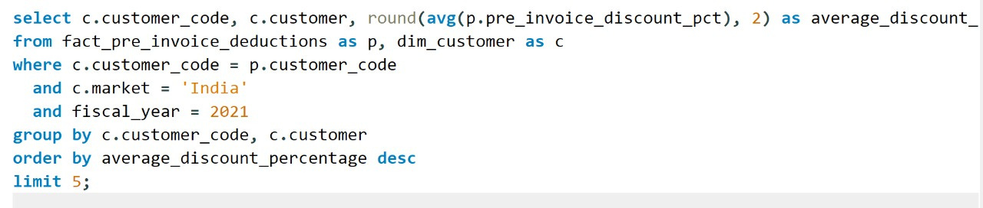
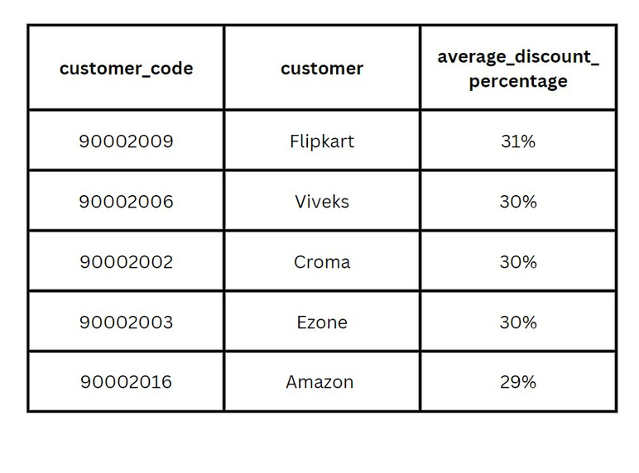
Generate a report which contains the top 5 customers who received an average high pre_invoice_discount _pct for the fiscal year 2021 and in the Indian marke
# Code
# Output
In the Indian Market 2021, Flipkart had the highest average pre-invoice discount percentage at 31%, and Amazon had the lowest at 29.3%.

Slide 11
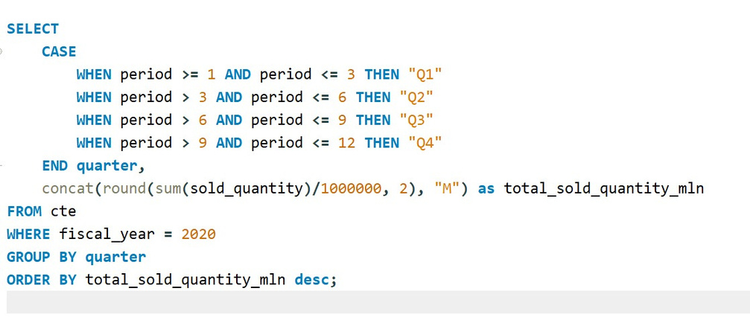
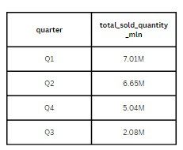
In which quarter of 2020, got the maximum total_sold_quantity?
# Code
# Output
The quarter with the maximum total_sold_quantity in 2020 is Q1, with a total sold quantity of 7.01 million.

Slide 12
Key Findings
.
Unique Products: The total unique product count saw a significant increase of 36.33%, rising from 245 in 2020 to 334 in 2021. This growth was driven primarily by the Accessories segment, which added 34 new products, and the Notebook segment, which added 16 new products, bringing their totals to 103 and 108, respectively. Overall, the Notebook segment boasts the highest product count with 129 products, while the Networking segment has the lowest with nine products.
Sales Performance: The quarter with the highest total sold quantity in 2020 was Q1, with 7.01 million units sold. This indicates a strong start to the year, although subsequent quarters saw a decline.
Market Insights: AtliQ Hardware operates in eight markets: Australia, Bangladesh, India, Indonesia, Japan, New Zealand, the Philippines, and South Korea. In the Indian market, Flipkart led with the highest average pre-invoice discount percentage at 31% in 2021, whereas Amazon had the lowest at 29.3%.
Product Costs: The product 'AQ Master wired x1 Ms' had the lowest manufacturing cost at $0.86, while 'AQ HOME Allin1 Gen 2' had the highest manufacturing cost at $263.42.
Channel Contribution: The "Retailer" channel was identified as the key driver, contributing to 73.22% of gross sales, highlighting its critical role in the company's sales strategy.
Segment Growth: Fiscal year 2021 saw an improvement in sales performance, especially notable in March and April , compared to the low sales during the same period in 2020.

Slide 13






AtliQ
Hardware
THANK YOU!
Ashish Kumar
+91 7004322827
ashishkumar.du.or.25@gmail.com
https://www.linkedin.com/in/ashish-kumar-044098297/
https://github.com/Ashish24062001?tab=repositories

